Slide 1
Advantages of Dimensionality Reduction
It helps in data compression, and hence reduced storage space.
It reduces computation time.
Helps to remove noise so that we can improve the performance of models
It also helps remove redundant features, if any.

Slide 2
Disadvantages of Dimensionality Reduction
It may lead to some amount of data loss.
PCA tends to find linear correlations between variables, which is sometimes
undesirable.
PCA fails in cases where mean and covariance are not enough to define datasets.

Slide 3
Different types of Dimensionality Reduction

Slide 4
Linear Dimensionality Reduction Methods
PCA
Factor Analysis
LDA
Non Linear Dimensionality Reduction Methods
MDS
t-SNE
HLLE
Spectral Embedding
Other techniques like
Auto encoders
Missing value ratio
Low variance filter

Slide 5
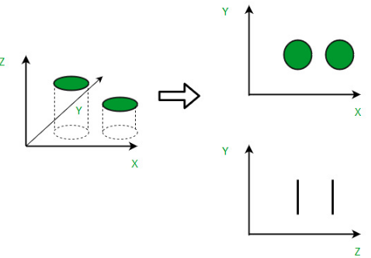
PCA – Principal Component Analysis

Slide 6
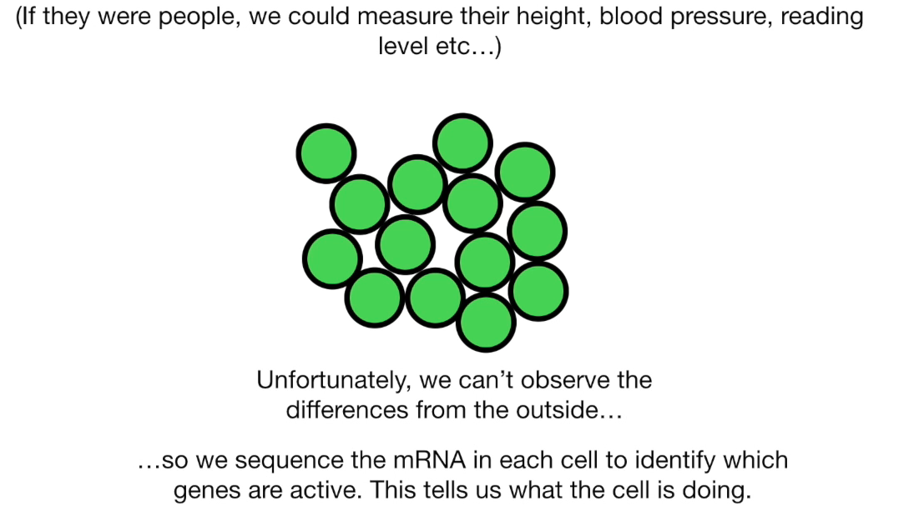

Slide 7
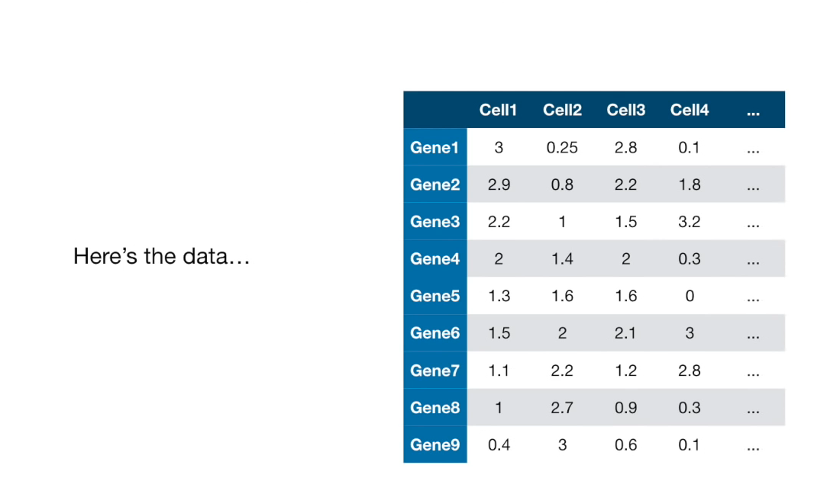

Slide 8
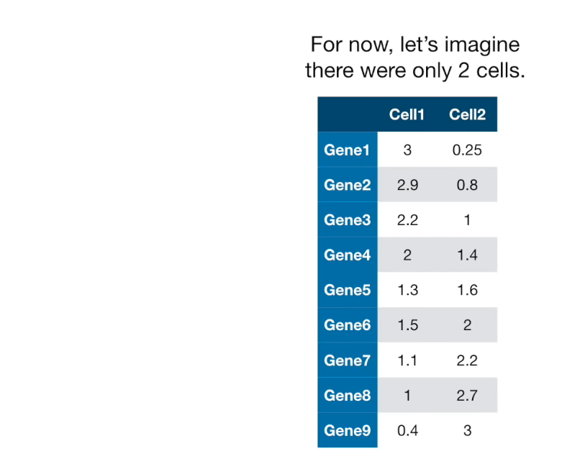

Slide 9
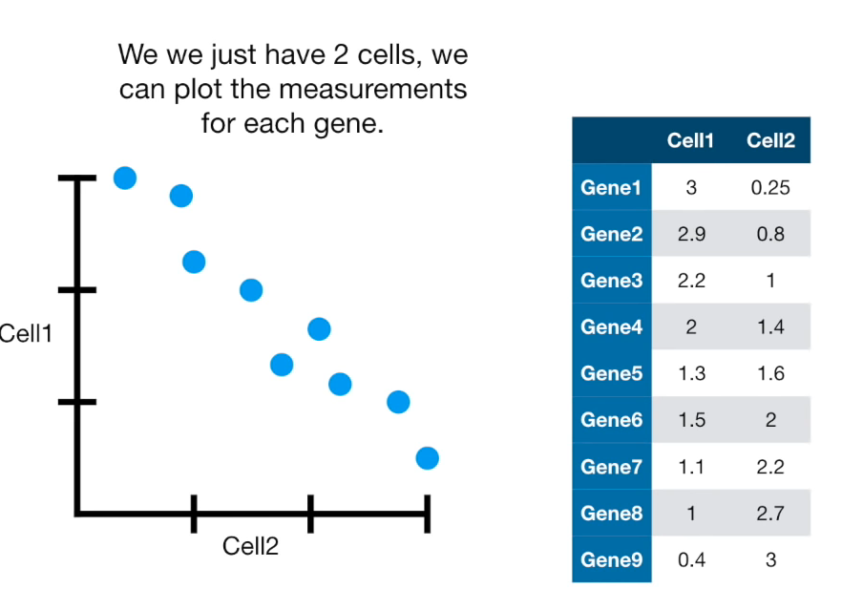

Slide 10
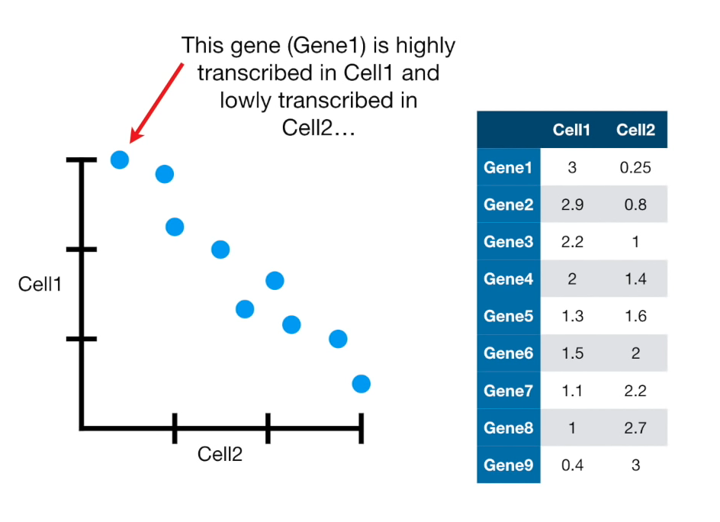

Slide 11
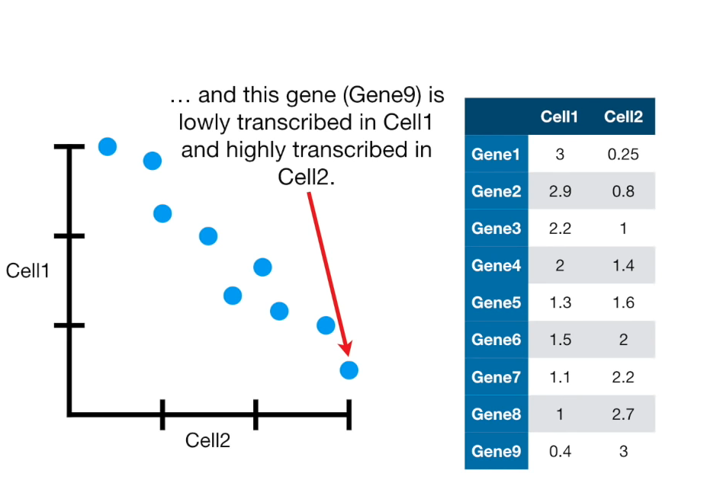

Slide 12
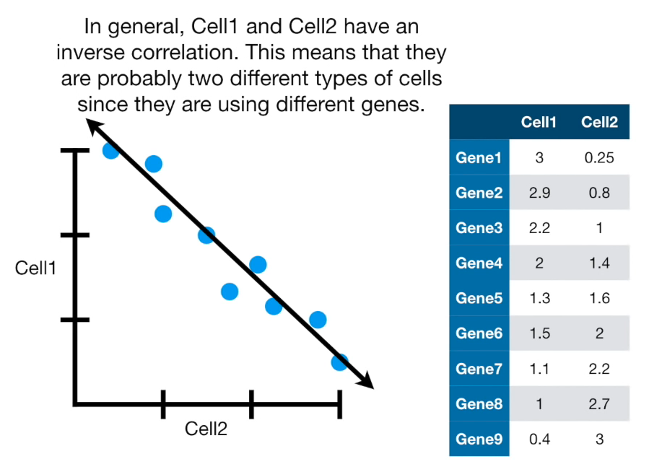

Slide 13
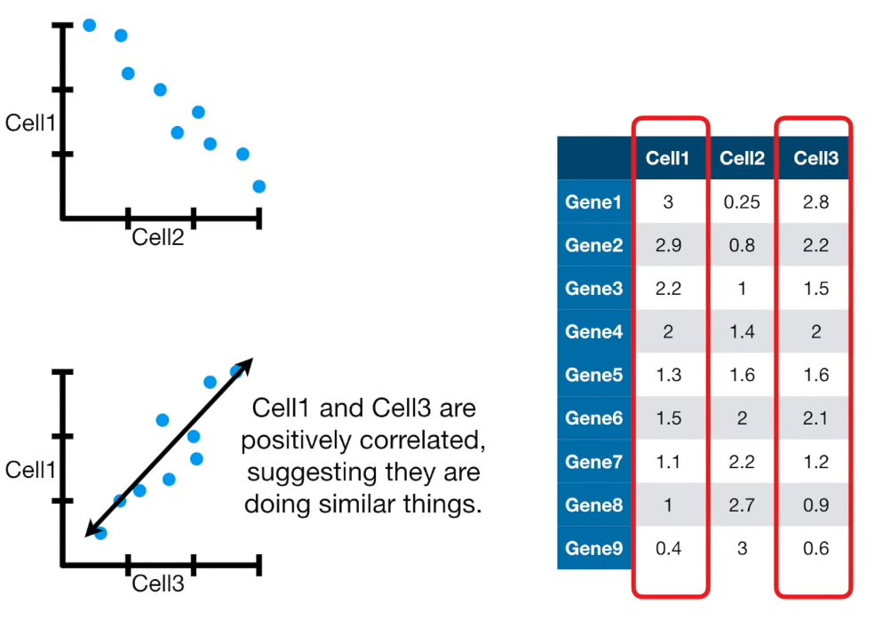

Slide 14
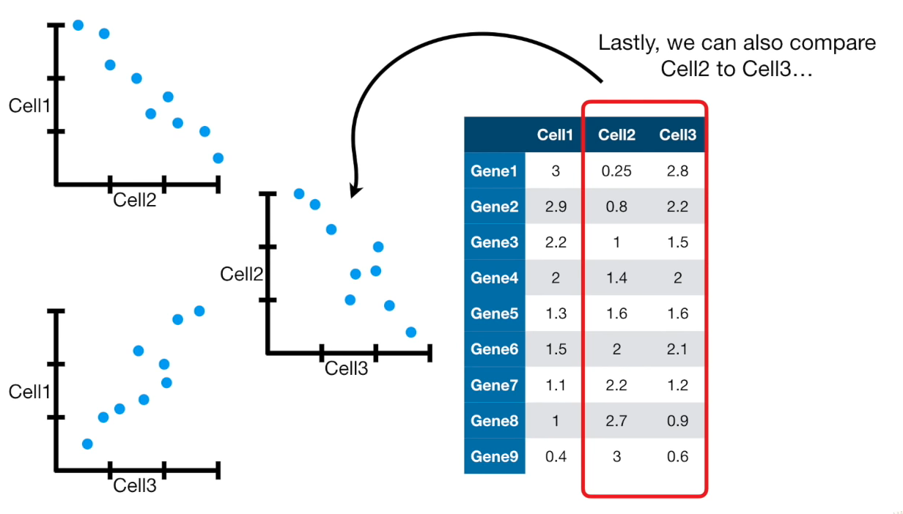

Slide 15
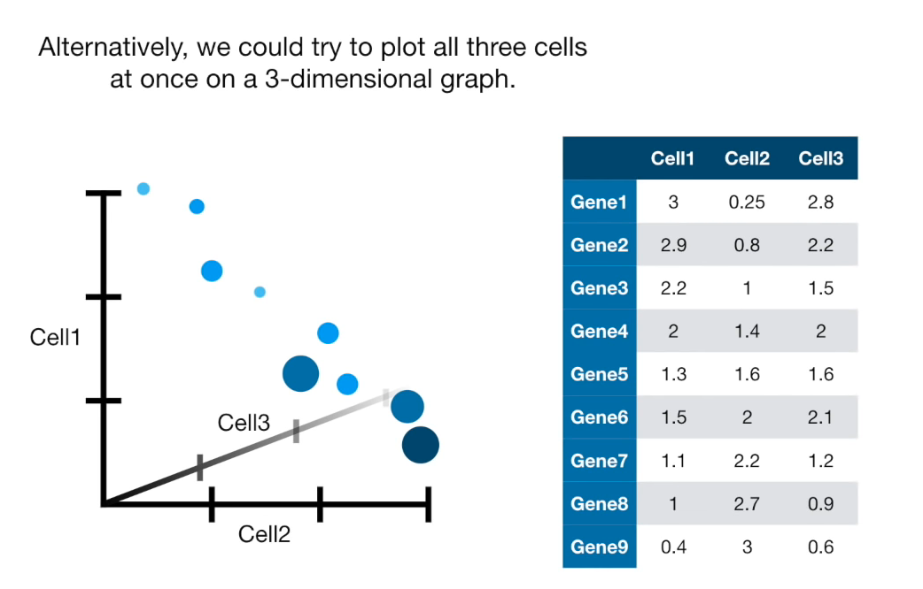

Slide 16
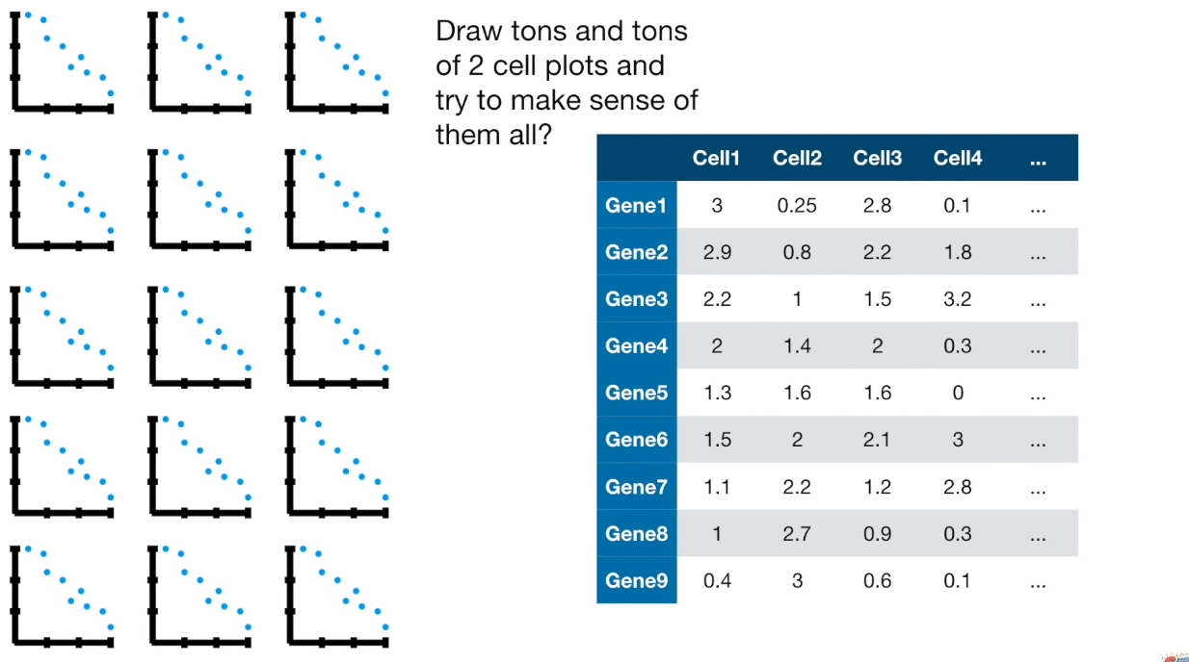

Slide 17
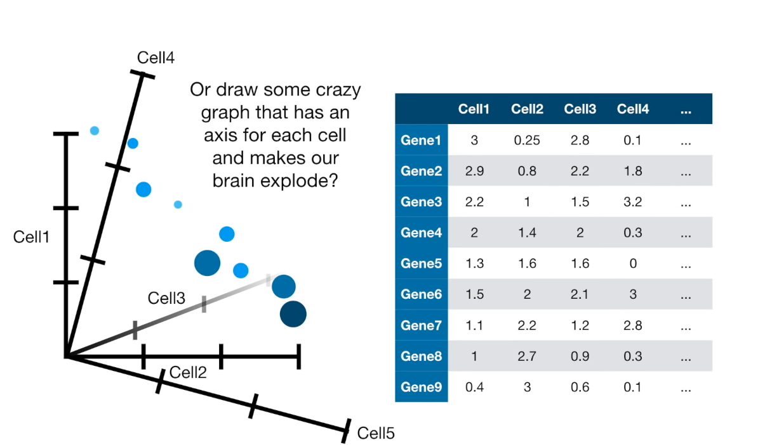

Slide 18
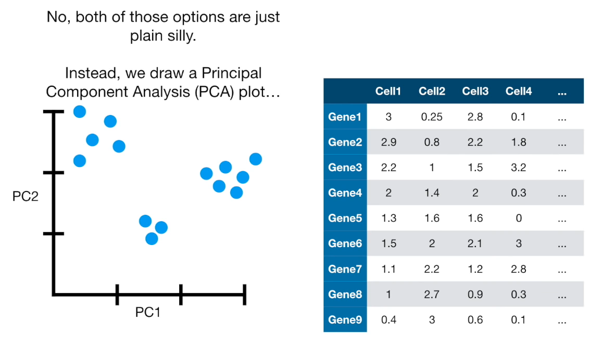

Slide 19
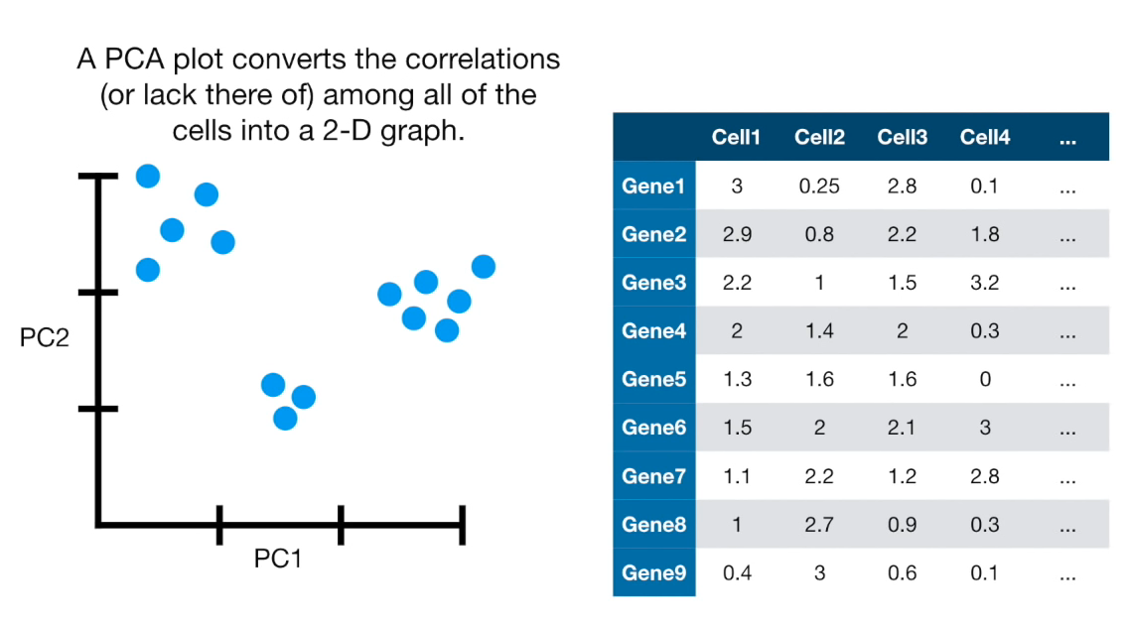

Slide 20
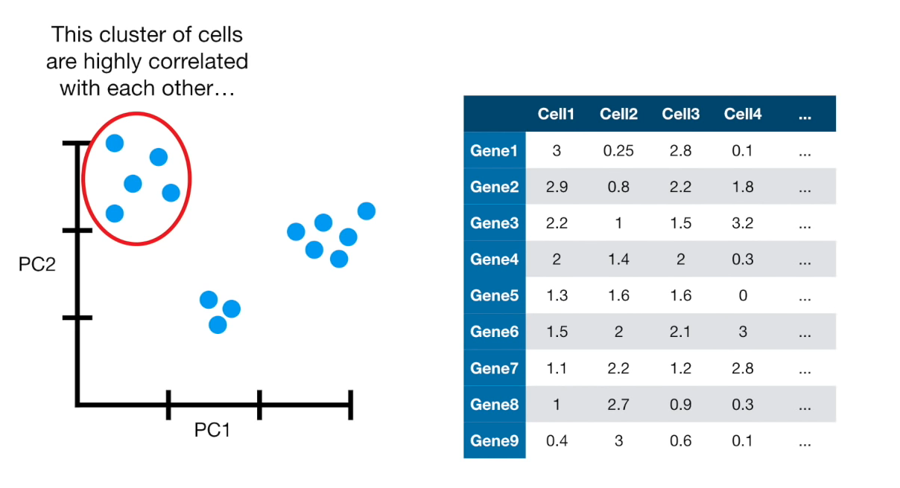

Slide 21
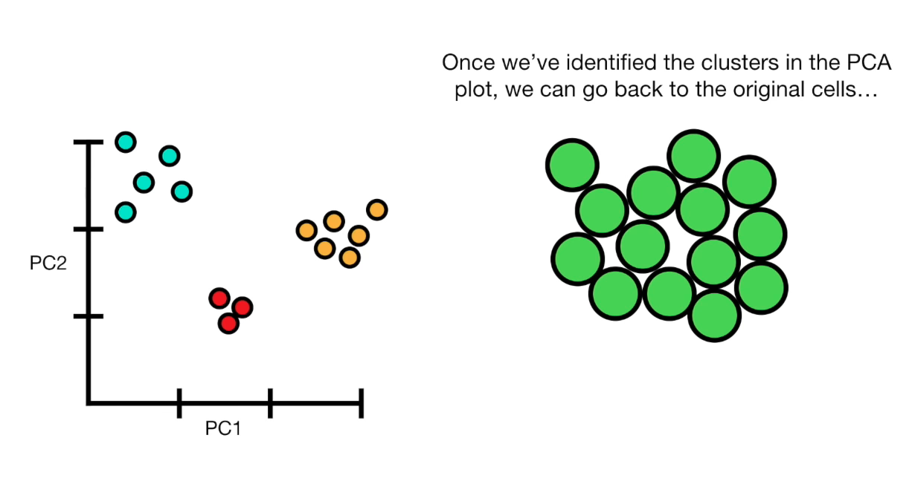

Slide 22
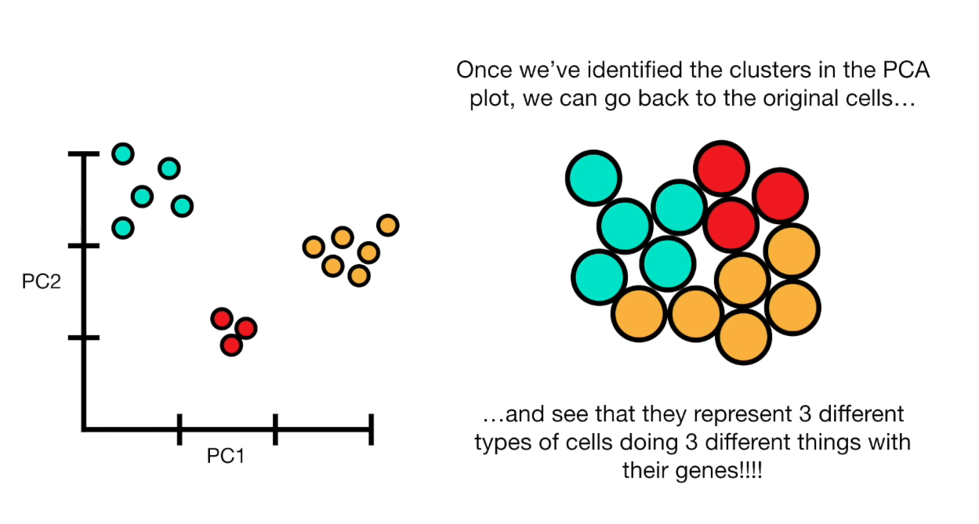

Slide 23
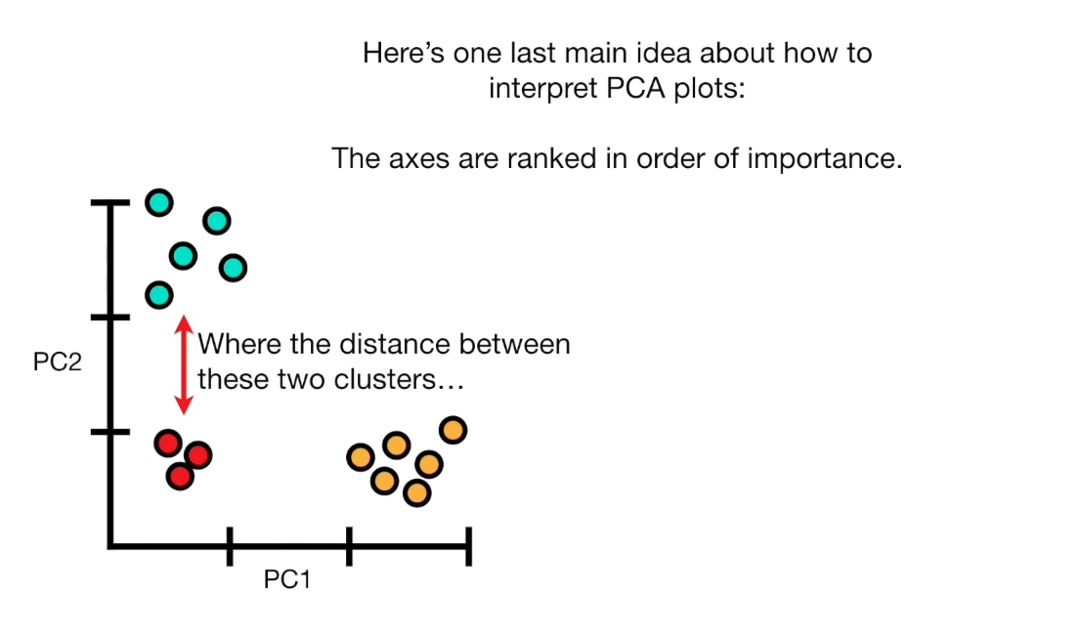

Slide 24
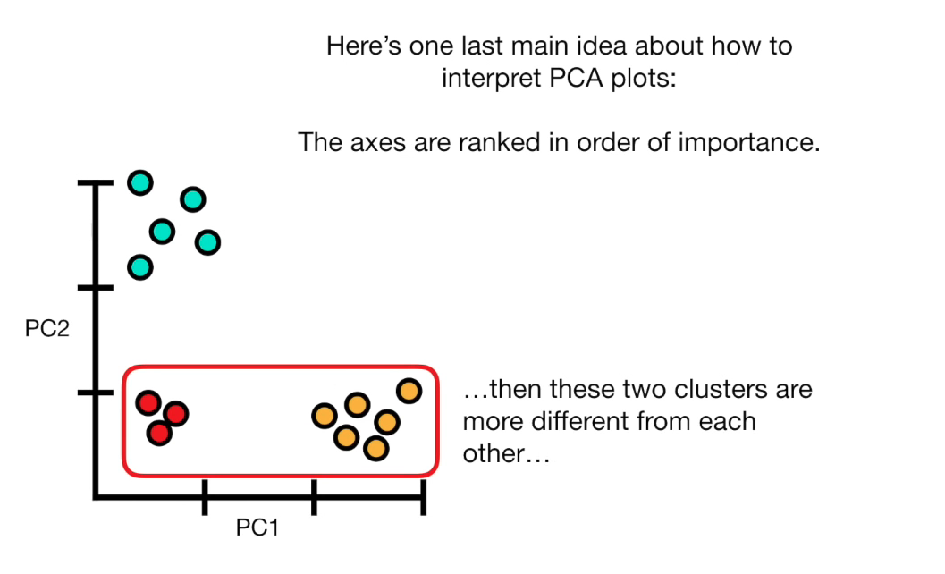

Slide 25
Let Implement PCA From Scratch Using Python

Slide 26
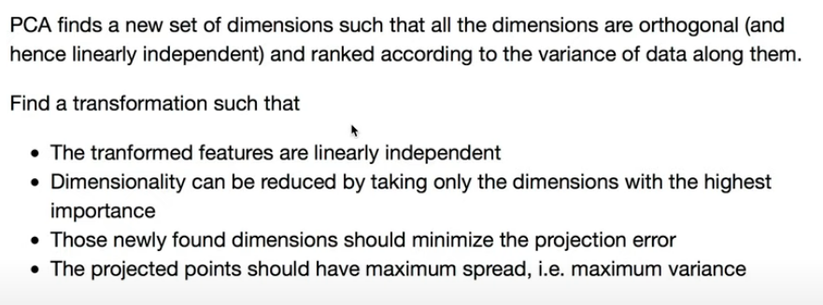

Slide 27
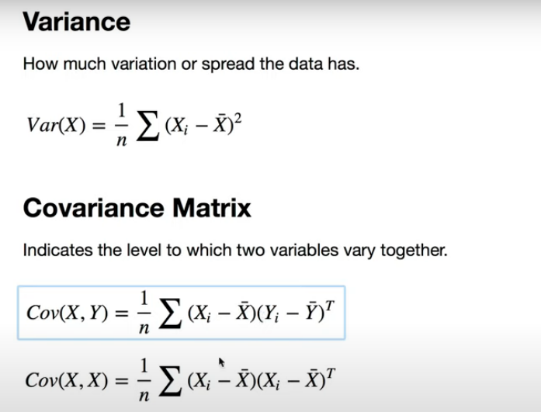

Slide 28
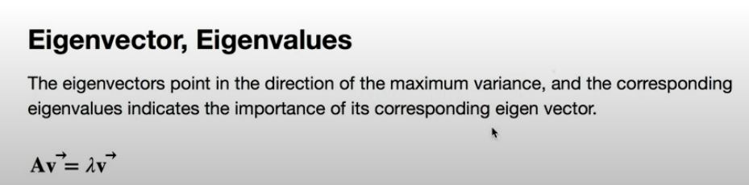
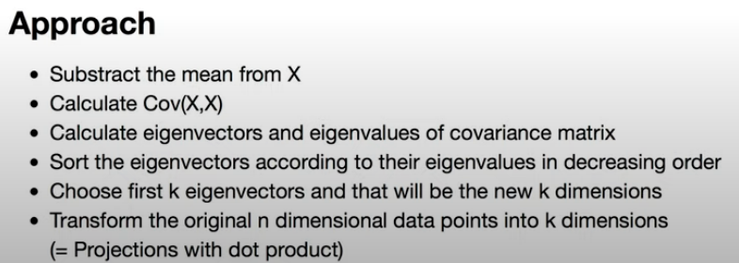

Slide 29
Summarize

